Slide 1
The Windows of our World
A Nottingham Schools Trust
Art Network Project
Reflecting on our time at home during COVID19 lockdown.
What we missed, what we enjoyed, what we will remember.

Slide 2
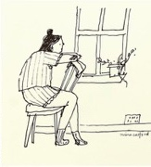
Everyday I look at the world from my window
All of us have had to spend time inside during the COVID19 pandemic.

Slide 3
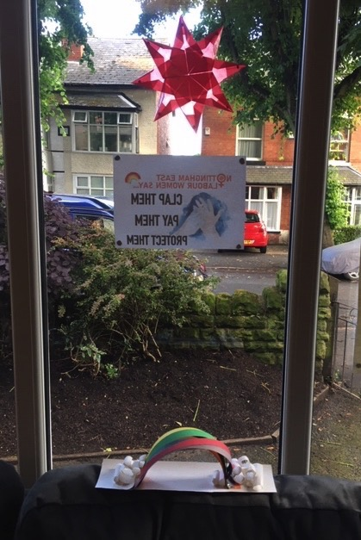
Everyday I look at the world from my window

Slide 4
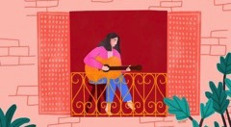
Everyone sees the world through their own window in their own way

Slide 5
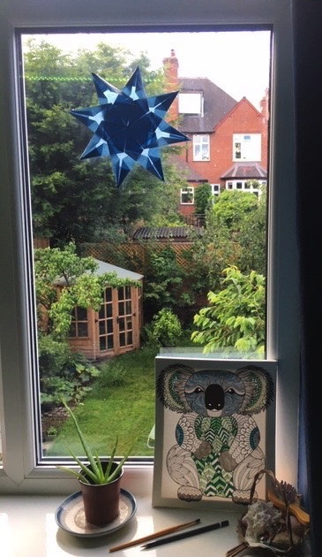
This is an art project for you to share some of things that are important to you during this time of lockdown:

Slide 6
The window of your world
Draw, paint or photograph a picture of what would be in the window of your world.
It could be:
The actual view from your window
The view would you would like to see
Something you missed doing
Something you enjoyed doing
Something you will remember

Slide 7
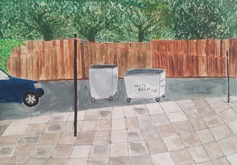
Artists’ paintings from their window
Clare Warde “Nuts About Life” May 2020
Featured on the Grayson Perry’s Art Club Channel 4

Slide 8
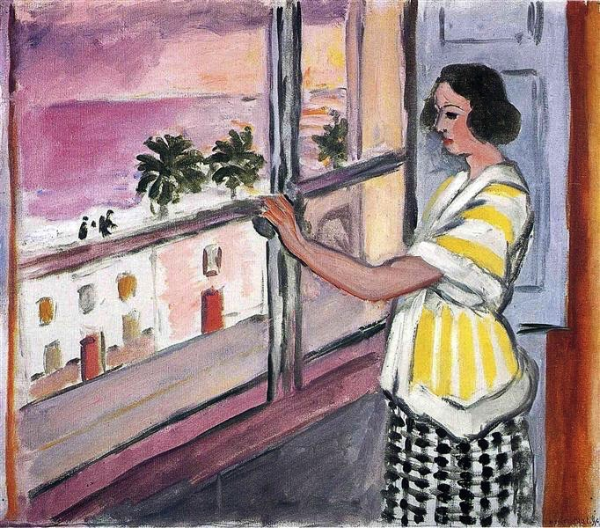
Young Woman at the Window, Sunset, 1921 - Henri Matisse

Slide 9
The Windows of Our World
Decide what you want to put in your window
If you are going to do the view from your window sit comfortably so you can see it and make a little sketch of all the things you see and will include in your final picture.
If you are going to use your memory or imagination, make a list of things you want to include and make a rough sketch of your ideas.
Then take your paper, draw a window frame around the edge and draw, paint or place your photographs in the frame - be as creative, expressive and colourful as you want to be.

Slide 10
Artists resources to support
The Windows of Our World
Nottingham Castle Trust
The Winifred Nicholson/Stanley Spencer learning programme has been asking children to create the view from their windows ala Nicholson and Spencer.
The Winifred Nicholson activity is here
http://www.nottinghamcastletrust.org/a-view-from-your-room/
The Stanley Spencer picture is here
https://www.artuk.org/discover/artworks/landscape-cookham-dean-berkshire-46858
This has been our most popular posting during lockdown and we’ve been sent many pictures created by young people in the city so would love to support this project with NST in any way useful – creating resources, providing experts online or via video, offering digital display space. Obviously the teachers and yourself will know better than me what may be needed but the creating of these Windowscapes could be something many many children could do and enjoy.
Gareth Morgan
Learning Development Officer – Nottingham Castle Trust
gmorgan@nottinghamcastletrust.org

Slide 11
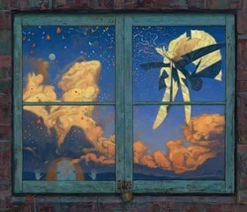
“Wonderful things…” The Red Tree by Shaun Tan
Theatre Design with Laura McEwen http://redearththeatre.com/shows/calm-and-creative-in-a-time-of-crisis/

Slide 12
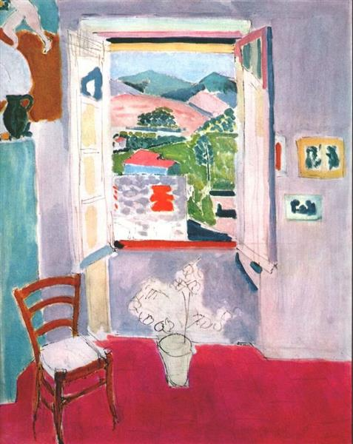
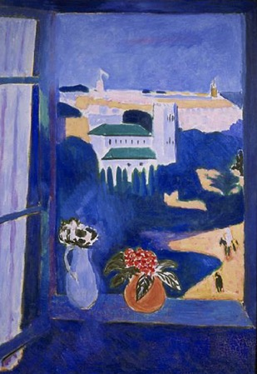
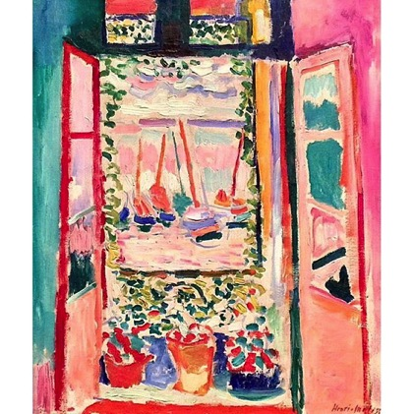
Henri Matisse A View through a window
Many famous artists have painted views through a window. As we are all inside, let’s create some Art based on the view through our windows.

Slide 13
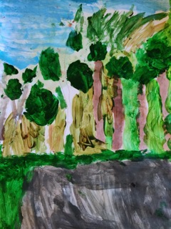
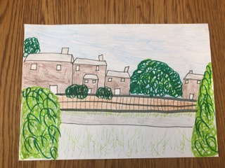
The Windows of Our World
We would love to exhibit your pictures on our school and Nottingham Schools Trusts website.
Please take a picture of your work (make sure there is a window frame around it) and sent it to your teacher and they may show it on the school’s and NST’s virtual gallery of WOOW!

